Slide 1

Hybrid Optical/Radio Frequency Communication
Channel Model
Ning Ni a1869549
2024-07-01

Slide 2
CONTENTS
Introduction and Background
Methods Design and Result
Conclusion and Future Work

Slide 3
01
Introduction and Background

Slide 4
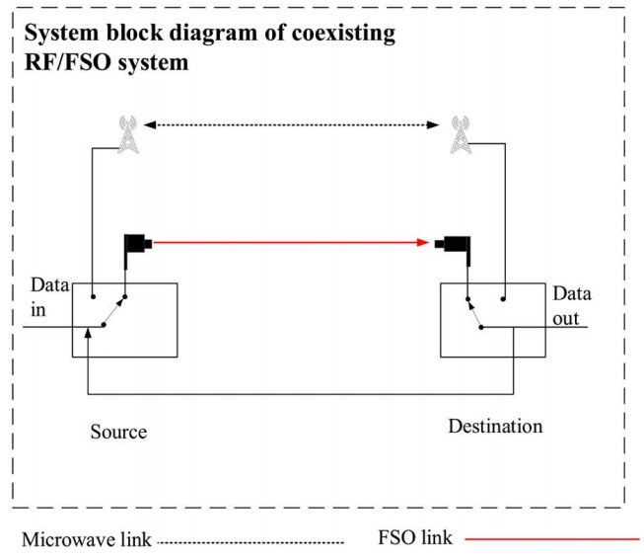
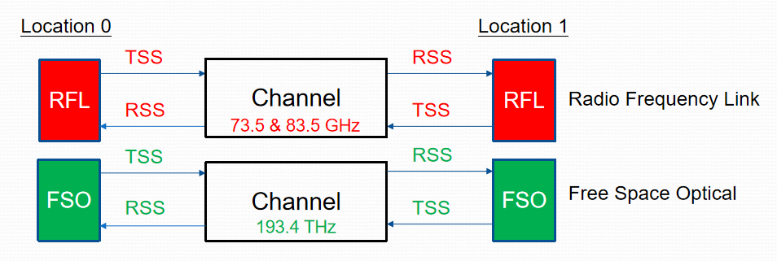
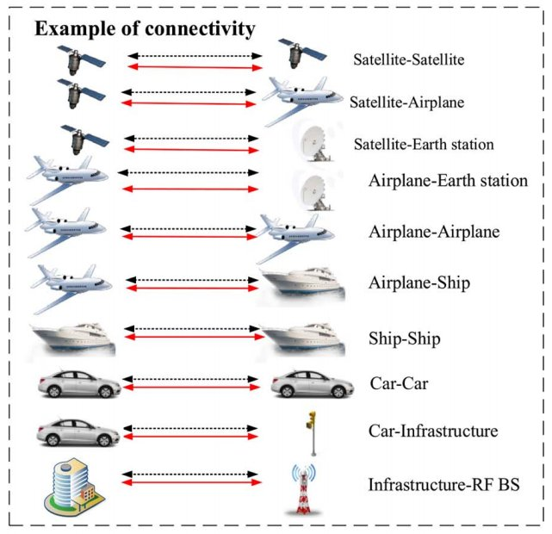
Brief Overview of Hybrid RFL/FSO Communication Systems
RFL: Radio Frequency Line
FSO: Free Space Optics

Slide 5
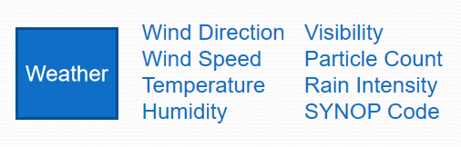
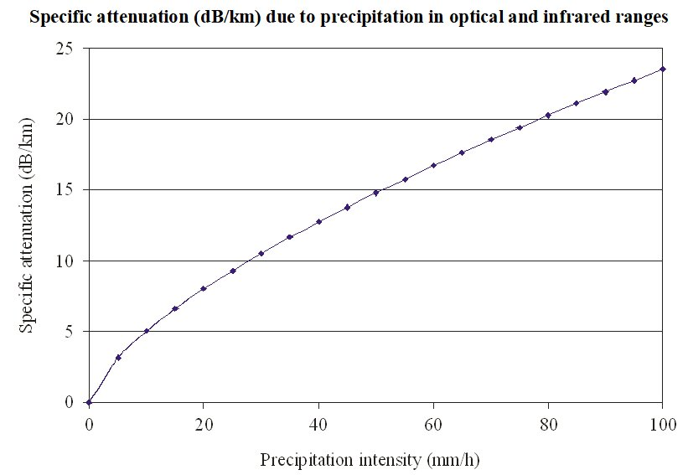
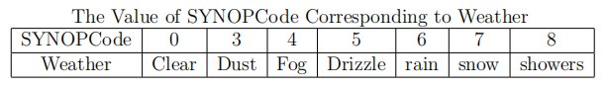
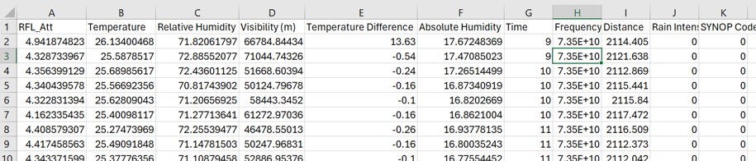
Importance of Understanding Weather-induced Channel Attenuation
Weather conditions impact signal transmission, affecting system performance

Slide 6
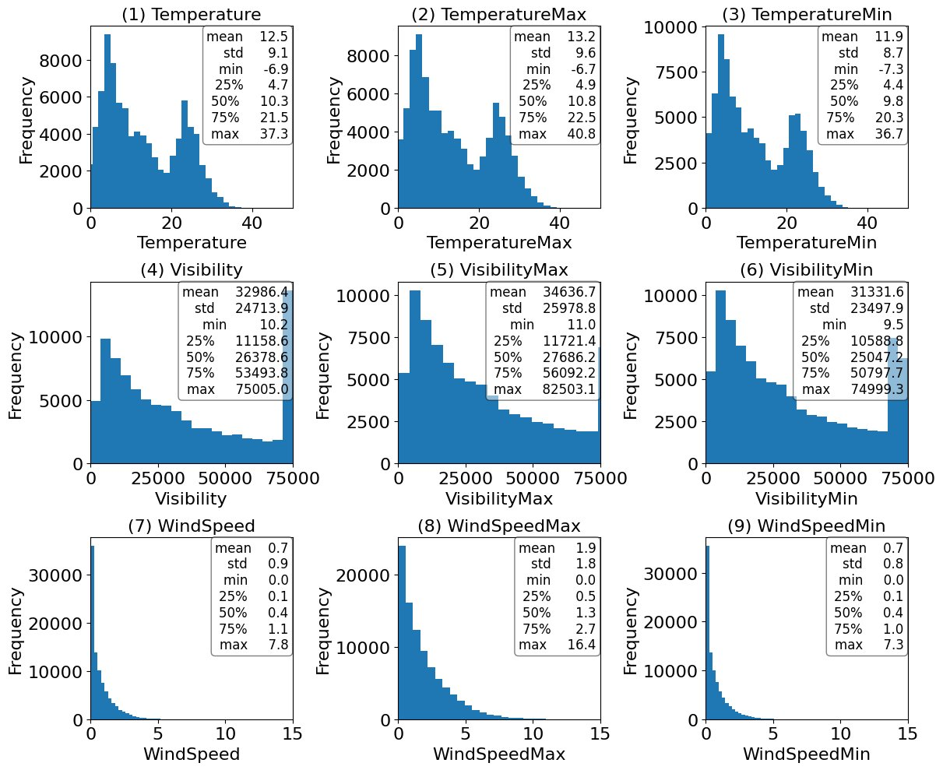
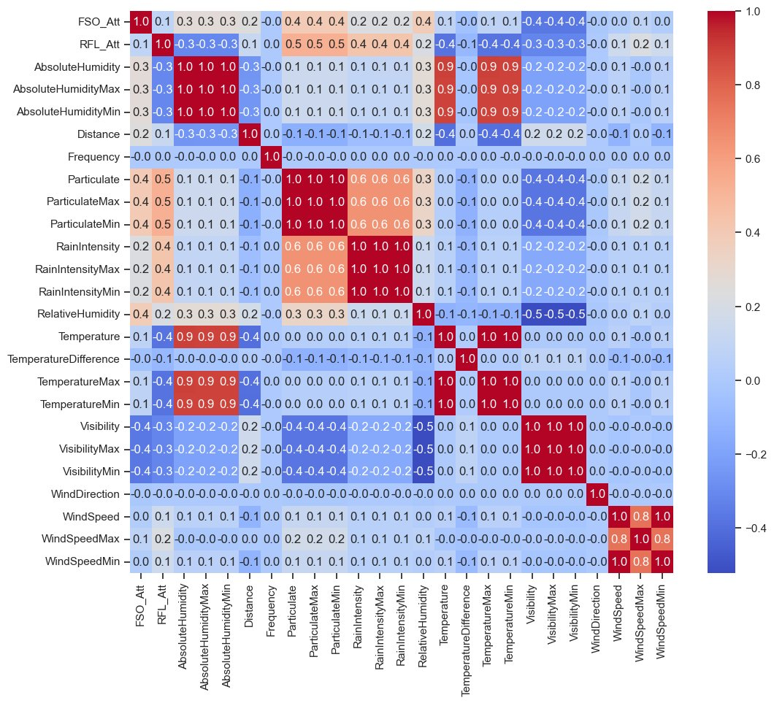
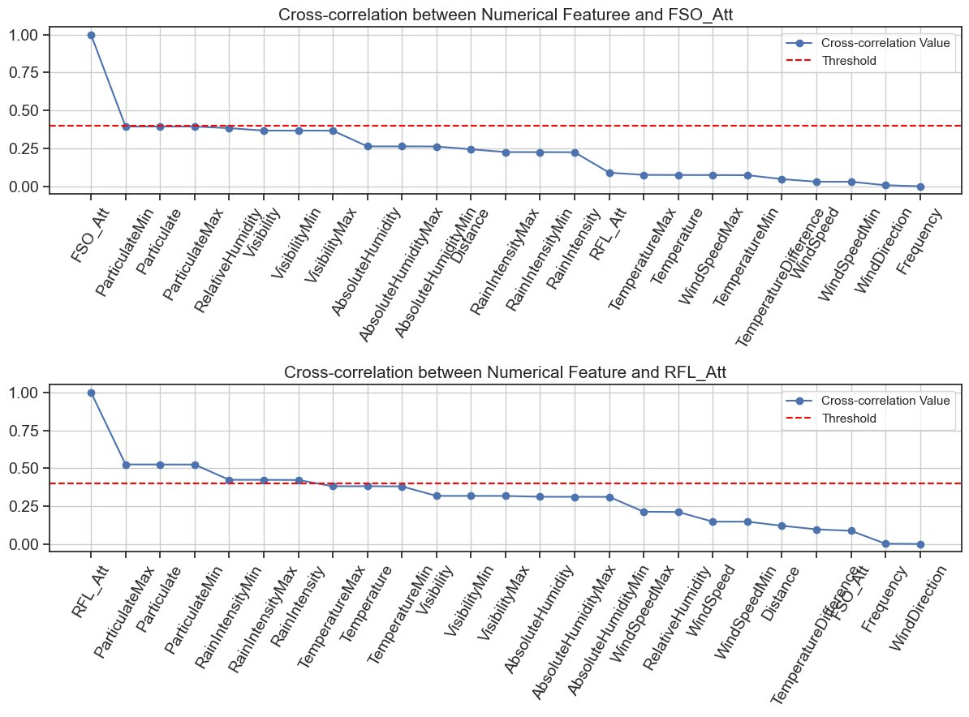
Exploratory Data Analysis (EDA)
Distribution Analysis of Predictor Variables
Correlation Analysis

Slide 7
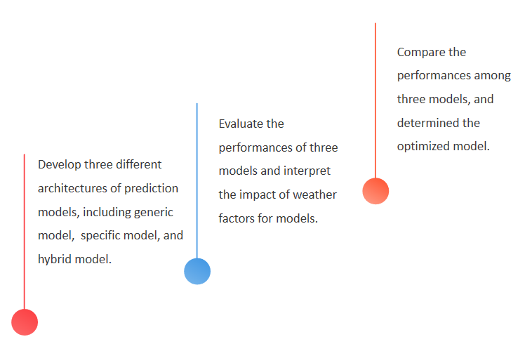
Objective of the Study

Slide 8
02
Methods Design and Result

Slide 9
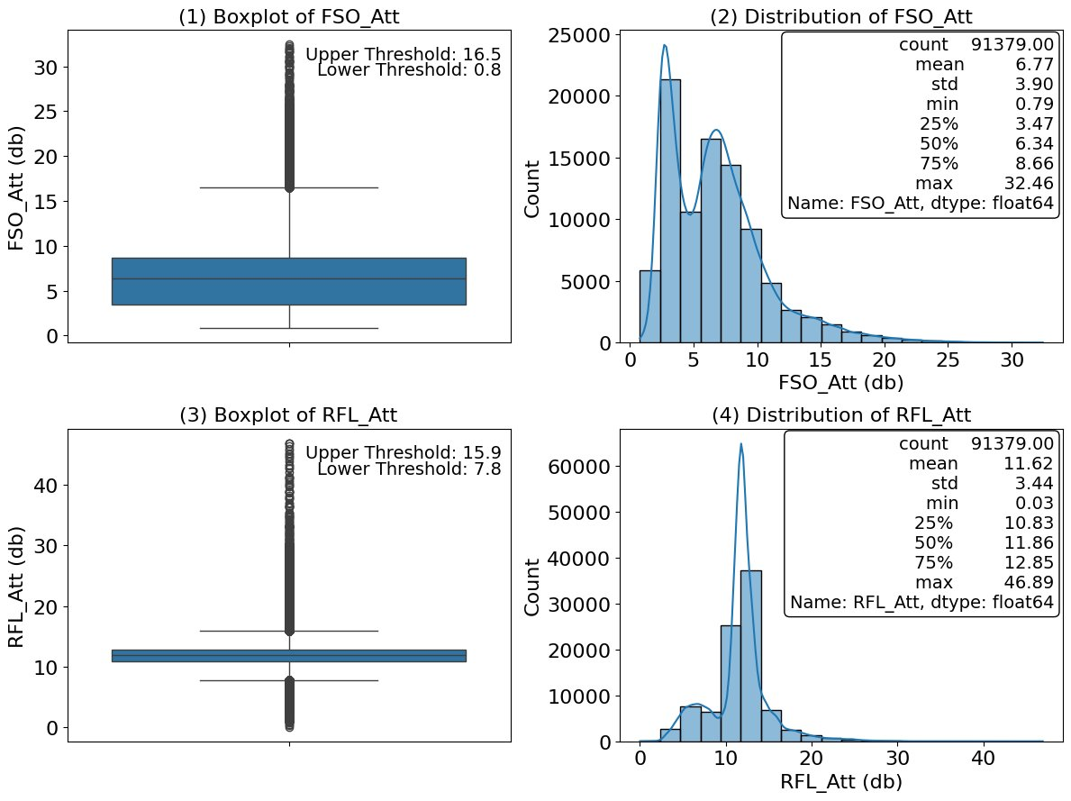
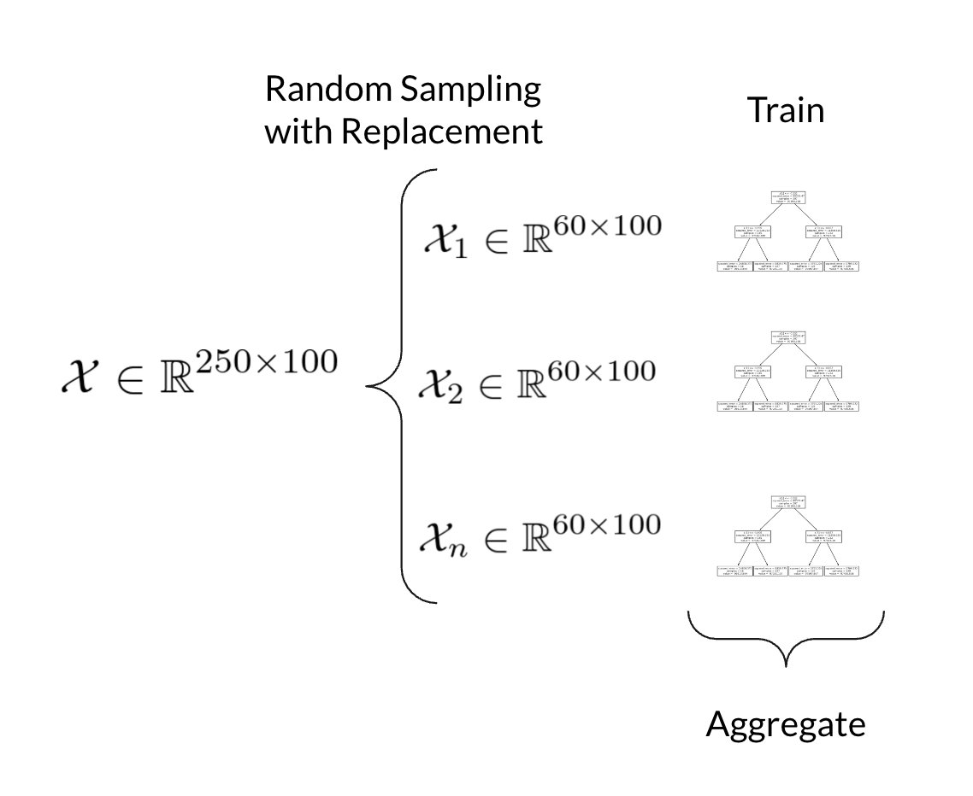
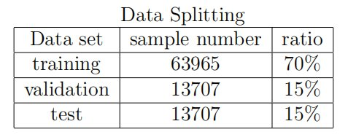
Model Selection and Design
Regression Random Forest
Decision Tree

Slide 10
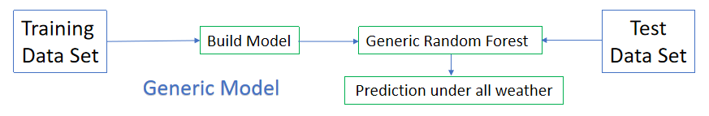
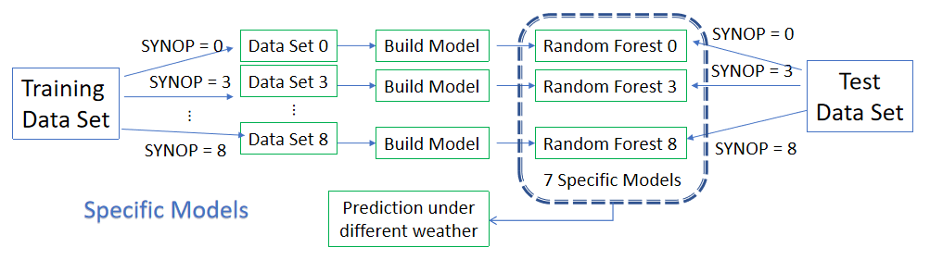
Model Selection and Design

Slide 11
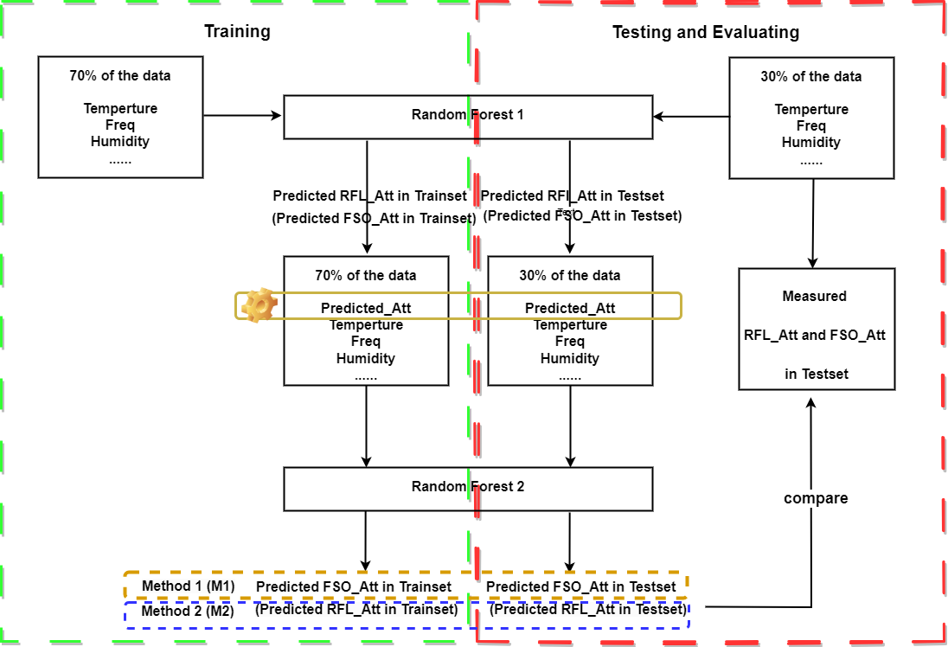
Model Selection and Design
Hybrid Models

Slide 12
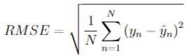
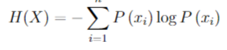
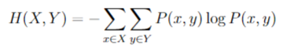
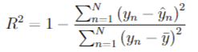
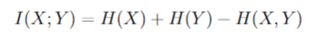
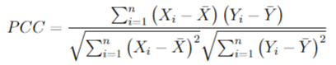
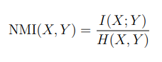

Evaluation Metrics
Mutual Information
RMSE
R-squared
Normalized Mutual Information
PCC
Pearson correlation coefficient

Slide 13
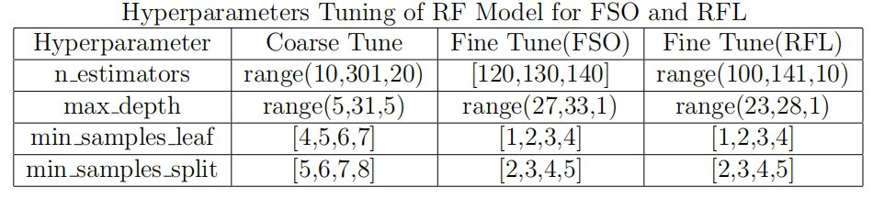
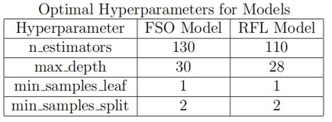


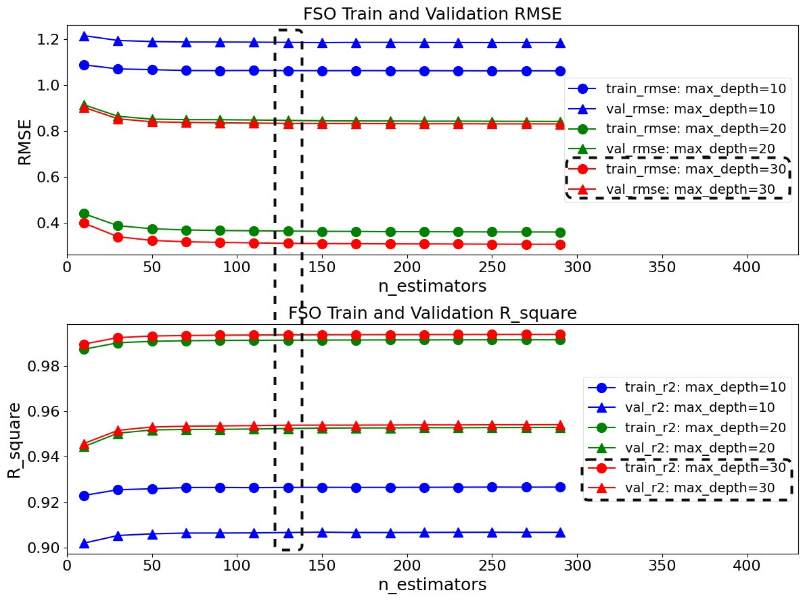
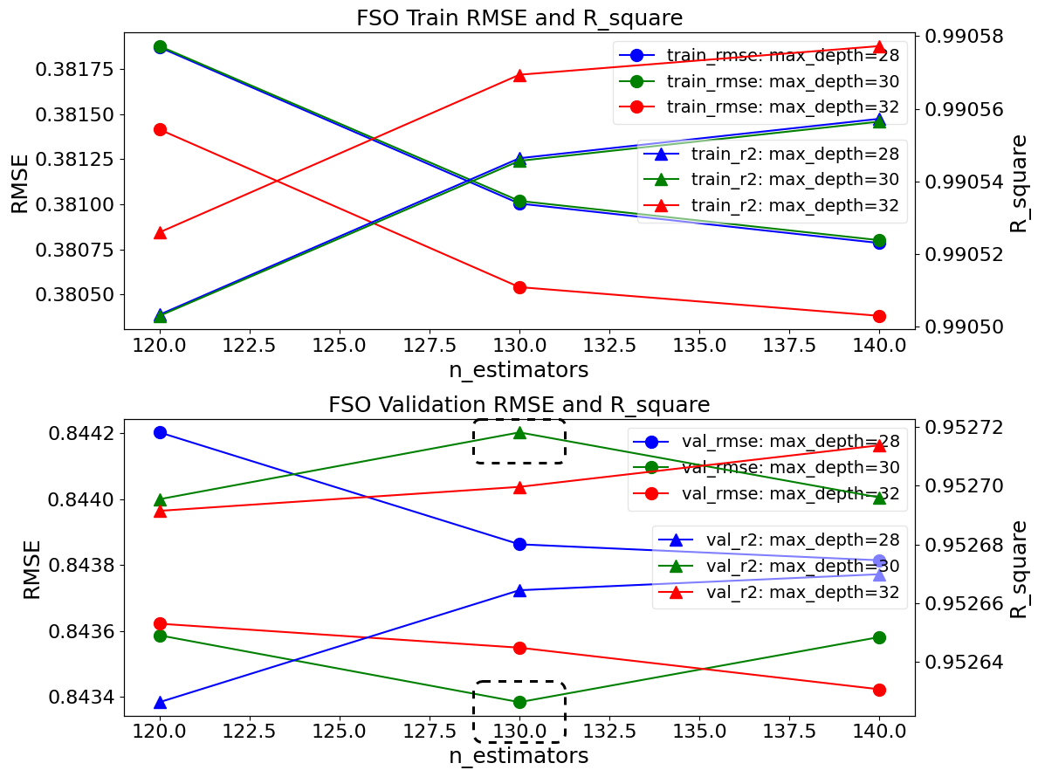
Generic Model Design - Hyperparameters Tuning

Slide 14
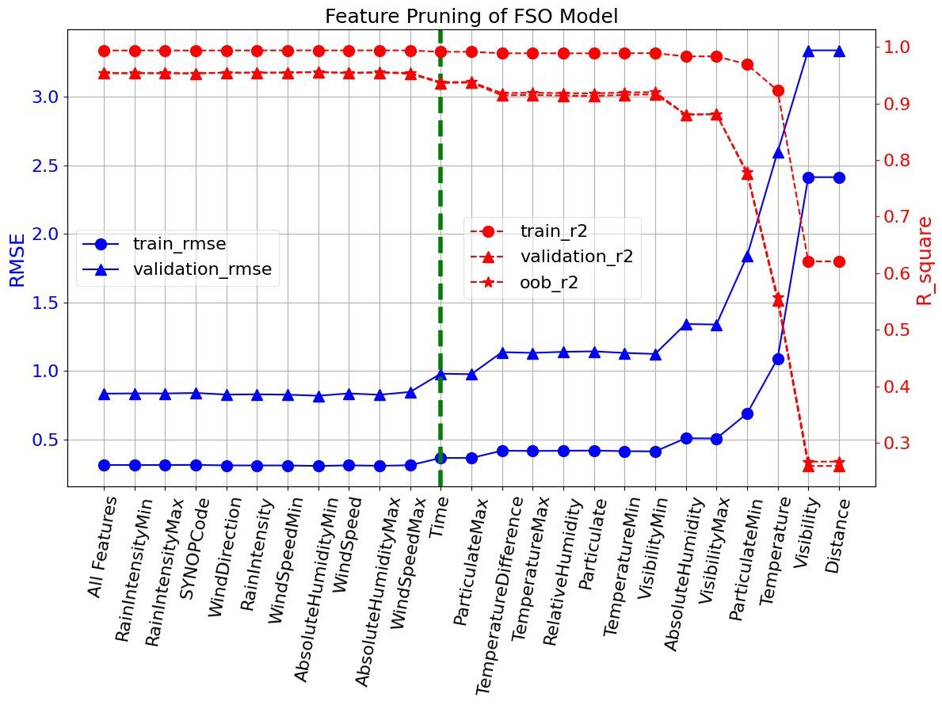
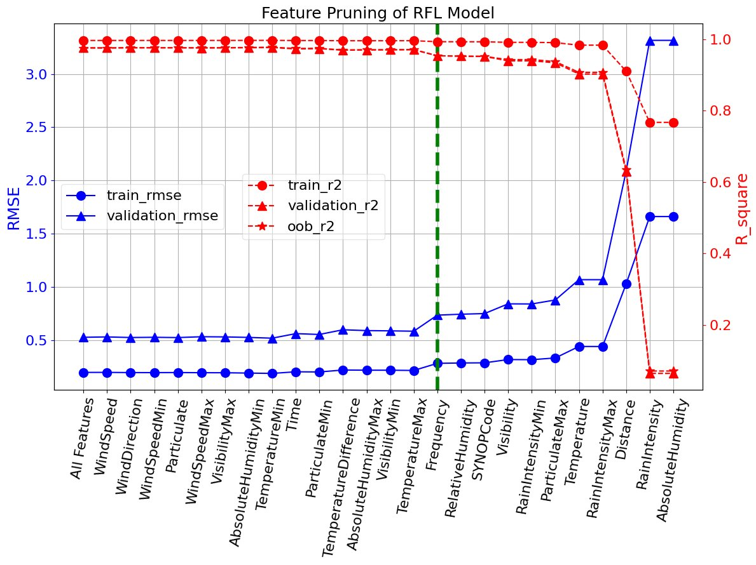
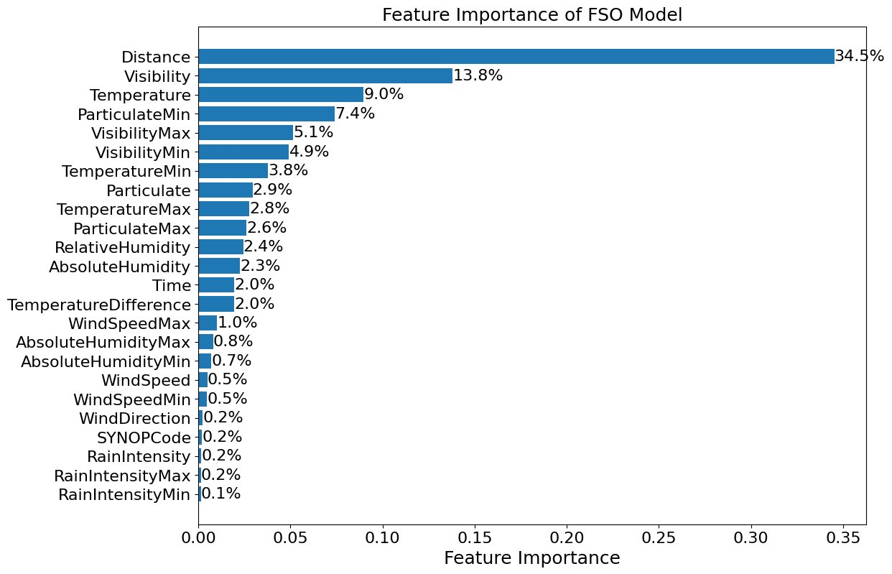
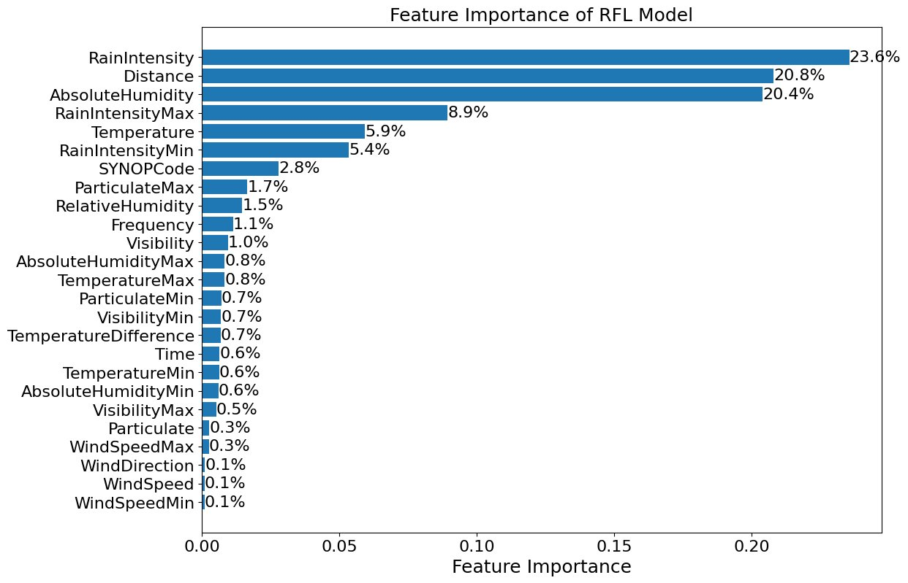
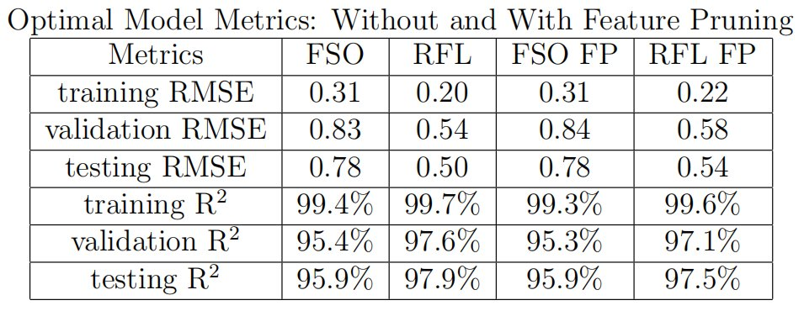
Generic Model Design - Features Importance and Pruning
Wrapper Methods

Slide 15
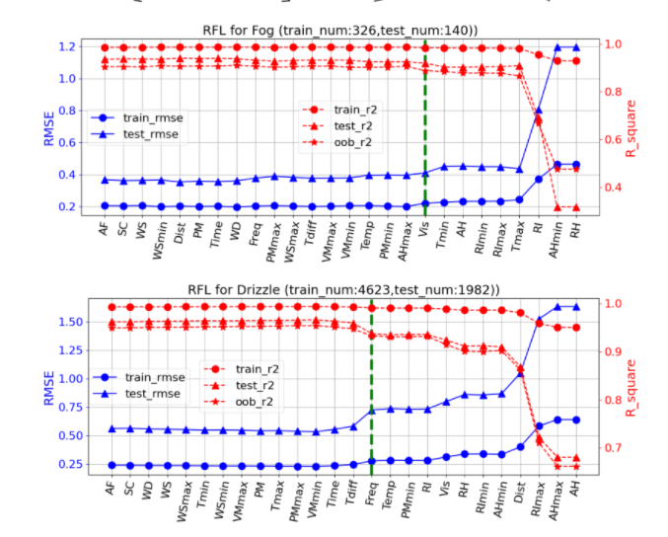
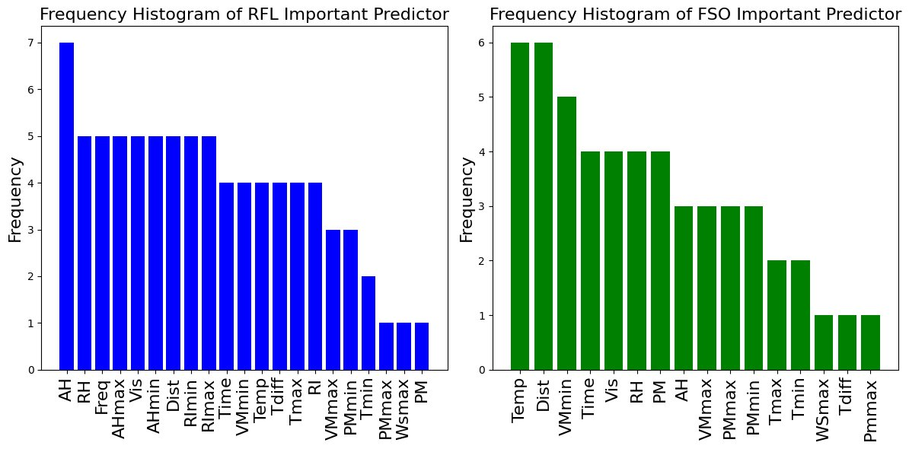
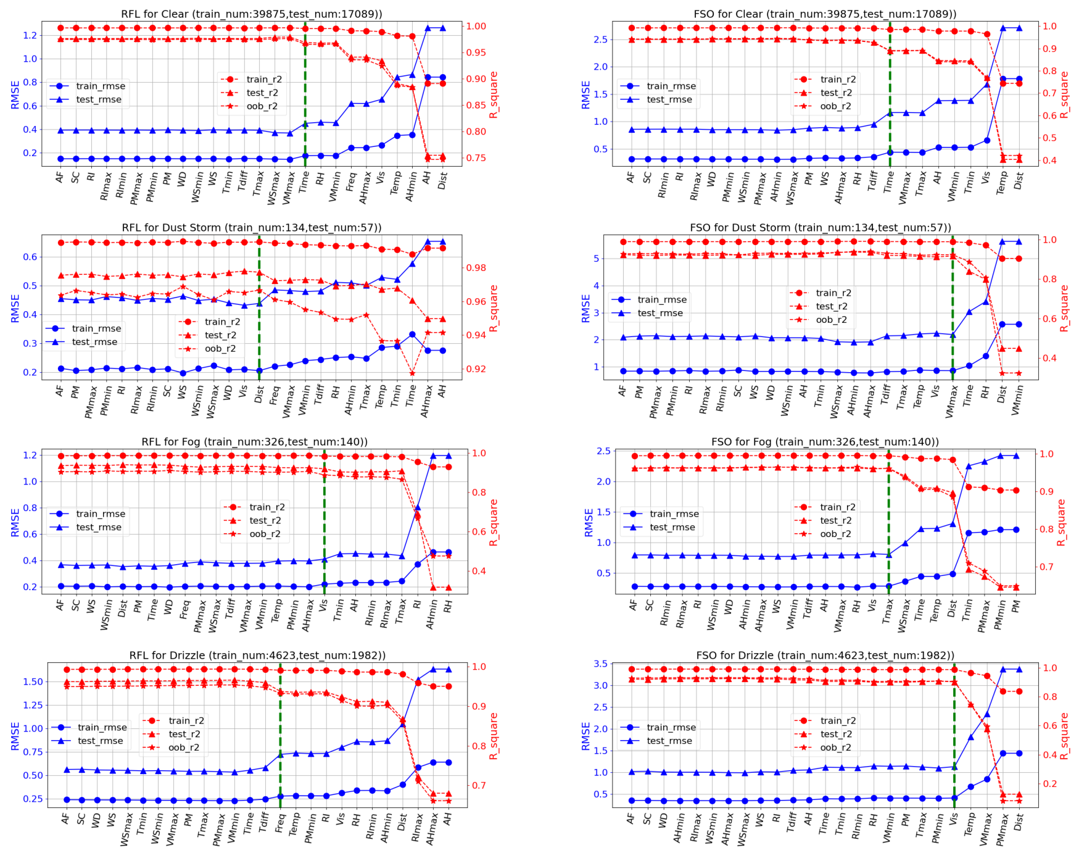
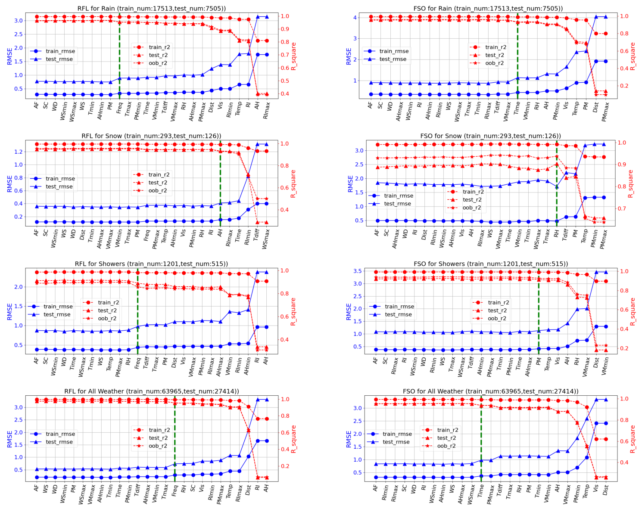
Specific Models Design - Features Importance and Pruning

Slide 16
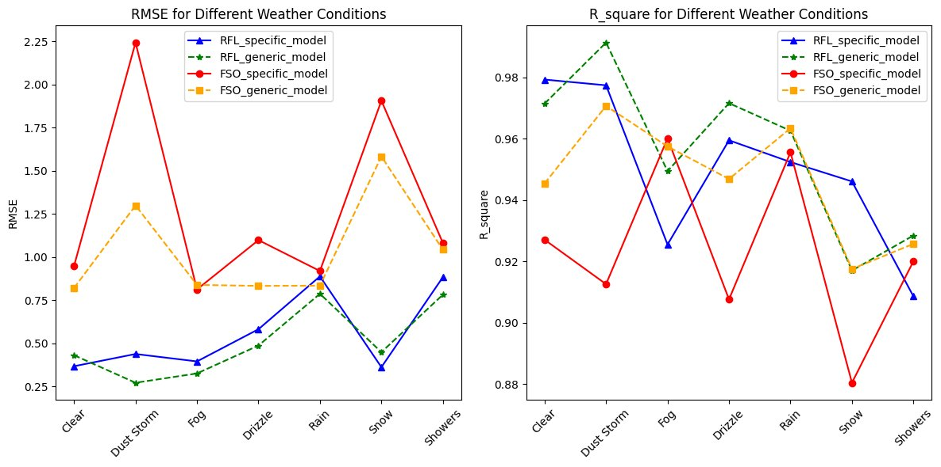
The Comparison of Results between Specific Models and Generic Model

Slide 17
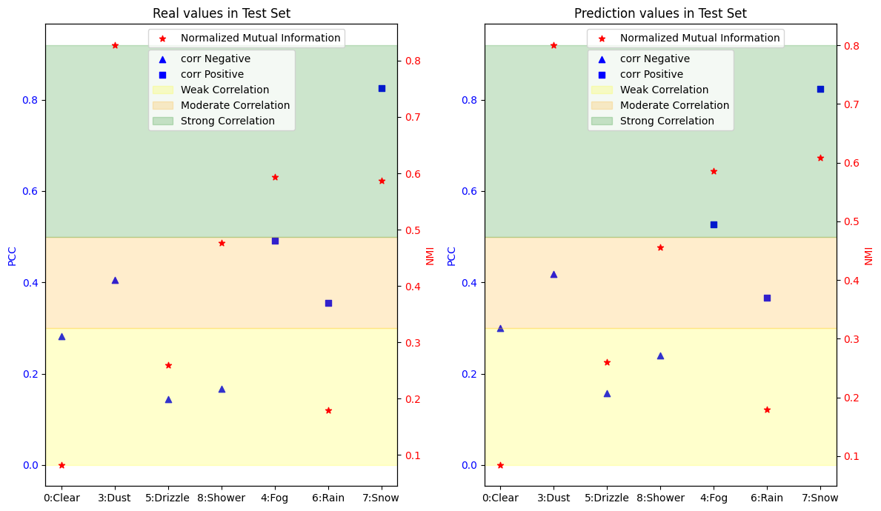
Hybrid Model Design - PCC and NMI

Slide 18
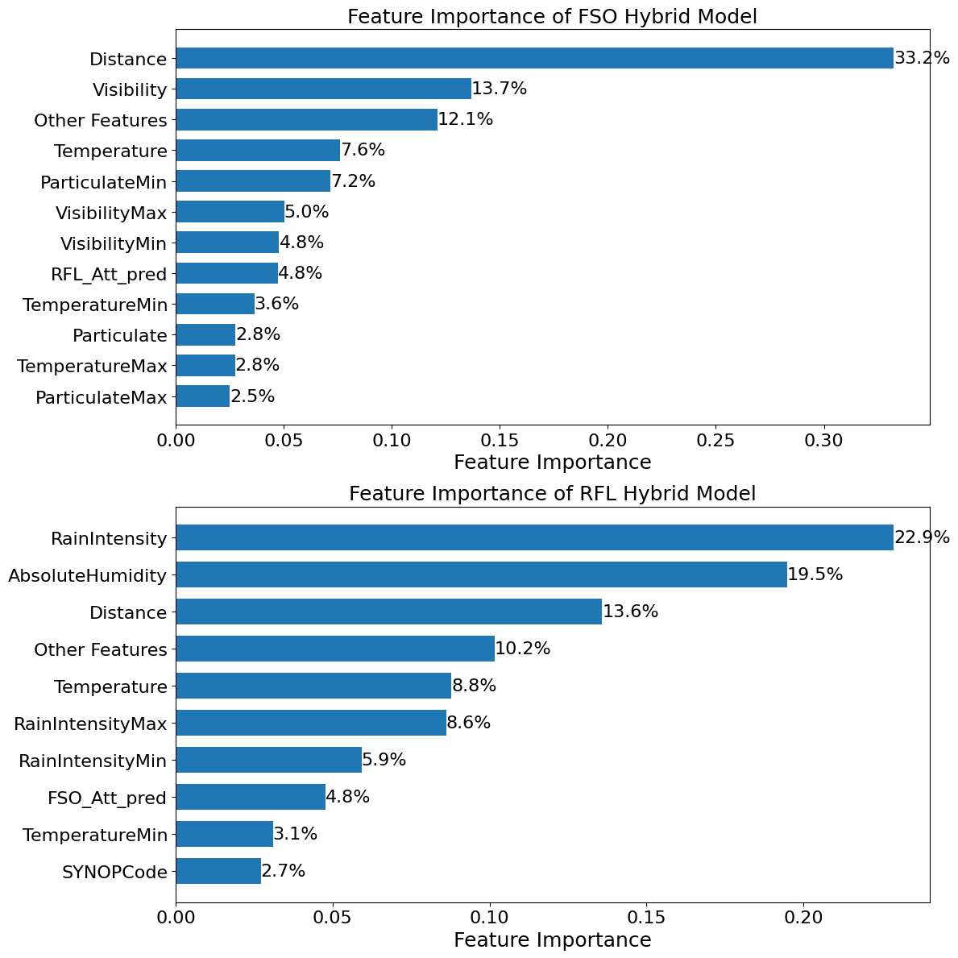
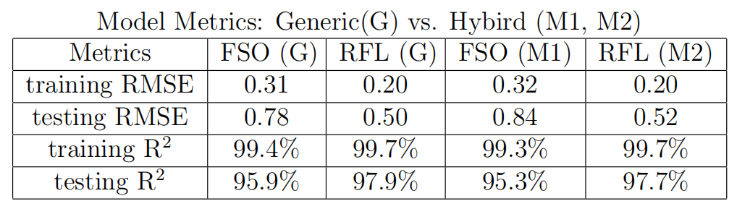
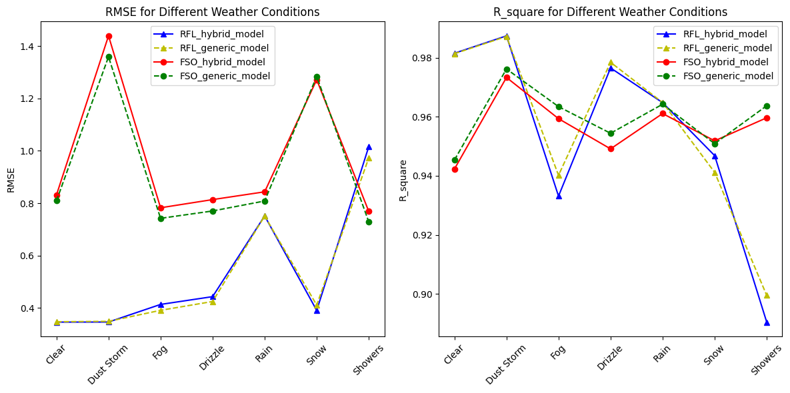
The Results of Hybrid Model

Slide 19
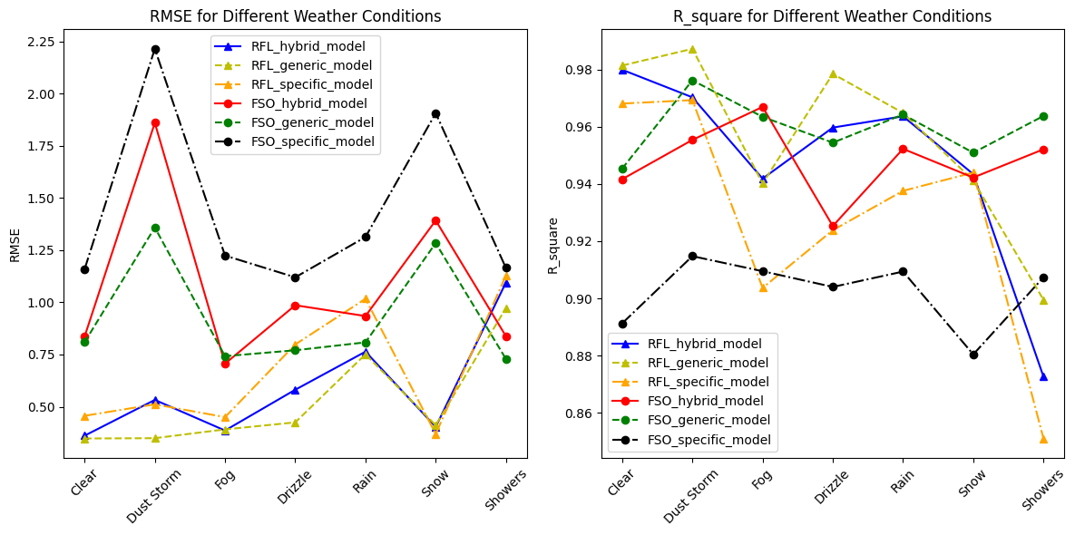
The Comparison of Results all Models

Slide 20
03
Conclusion and Future Work

Slide 21
Conclusion

Slide 22
Conclusion
Performance：generic > hybrid > specific

Slide 23
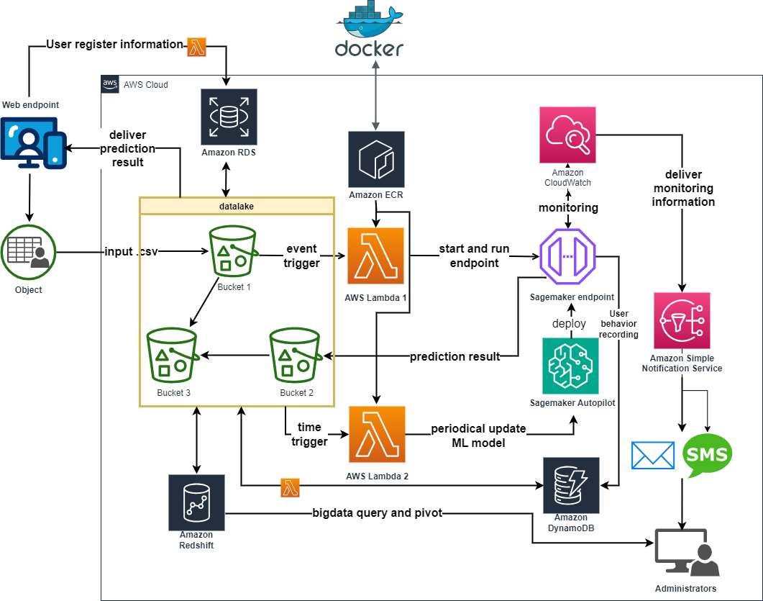
Furture Work
1. Other ensemble algorithm, like Adaboost, Xgboost, etc.
2. Deploy the model based on AWS Cloud to provide prediction service online. This enables my research to be translated into practical software products.

Slide 24

I declare that all the analysis and experimental processes and results were completed by myself.
THE END
THANKS
Email: niningkings@gmail.com

